Slide 1
Final Project Overview
“Visualization in 3 Parts”

Slide 2
3 Parts
Individual
Peers
General Public
Minimum of 3 visualizations each They do NOT have to be interactive
You will submit 3 IPYNB files as links to your github, with the following naming convention:
IS445_Lastname_Firstname_Individual
IS445_Lastname_Firstname_Peers
IS445_Lastname_Firstname_General_Public

Slide 3
Individual Part
Identify a dataset to explore.
This will be iterative! You probably won't get one you like on the first try.
Check out sources like data.world, data.illinois.gov, data.gov, developer.marvel.com, IDB, etc.
or the dataset doc that lives right here
Explore the dataset in a Jupyter notebook. Make sure you include things that did and did not work.
Summarize the characteristics of the dataset in words: what does it represent, what are the fields/columns/rows, what data types are they, etc

Slide 4
Individual Part Cont
Your datasets need to be submitted as well. To do this, include this information in your Jupyter notebook:
What is the "name" of the dataset?
Where did you obtain it?
Where can we obtain it? (i.e., URL)
What is the license of the dataset? What are we allowed to do with it?
How big is it in file size and in items?

Slide 5
Individual Part Cont
You can share raw data sets and sources, ask questions about reading/modifying the dataset and post code that isn’t working to a discussion board.
DO NOT SHARE WORKING CODE

Slide 6
For Peers
Submit an IPYNB file
Peer is defined as someone who is interested in what you’re interested in, not the class. For Example, if you use a dataset based on Basketball, peer would be someone else who likes basketball, not necessarily classmates.
Make the visualizations detailed, more advanced than for the general public.

Slide 7
For General Public
This is for the general public
Visualizations should be simple, easy to understand

Slide 8
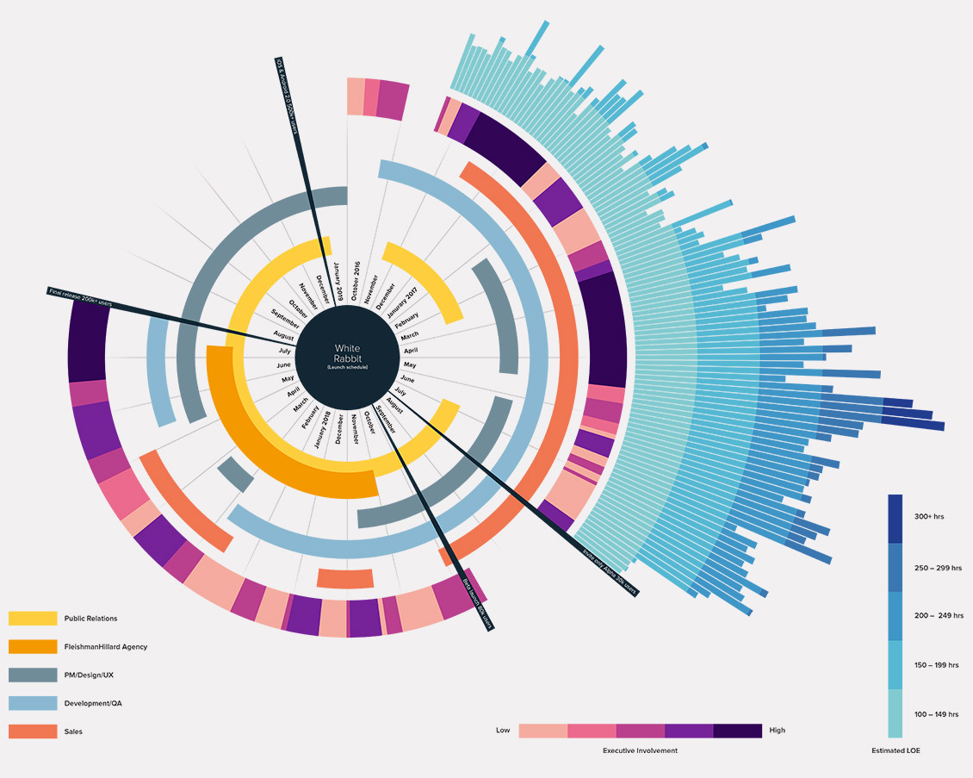
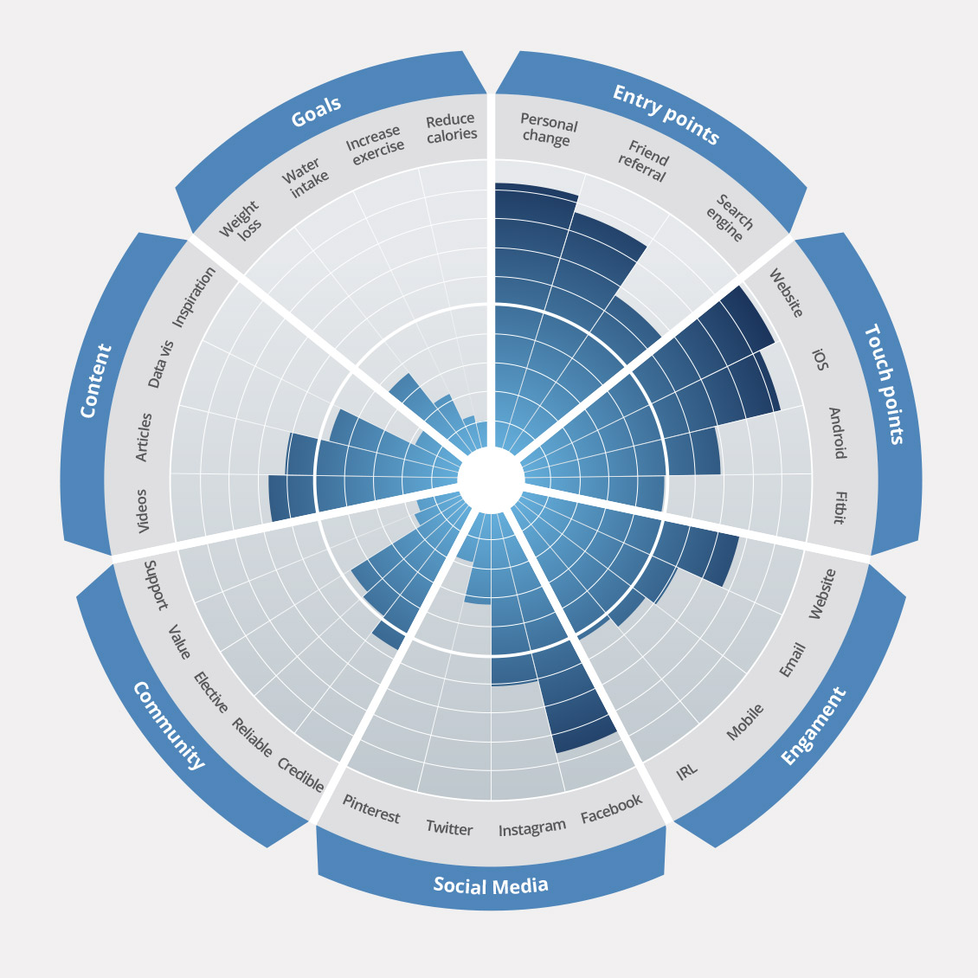
Self/Peers (left) vs General Public (right)

